Slide 1
Ultimate Enterprise Kubernetes Governance Architecture similar to what banks, fintech, and regulated enterprises implement (PCI-DSS, RBI, SOC2, ISO27001 compliant environments). This is a Level-5 governance architecture (fully automated DevSecOps governance platform).

Slide 2
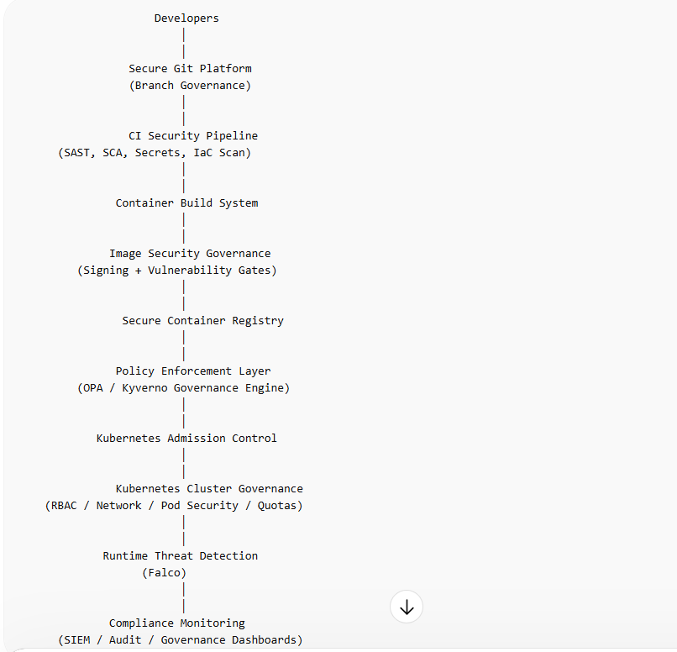
Ultimate Kubernetes Governance Architecture (Bank Grade) High Level Architecture Flow

Slide 3
Enterprise Governance Layers (Bank Model) Banks usually implement governance across 7 control layers:
1 Source governance 2 Pipeline governance 3 Image governance 4 Deployment governance 5 Cluster governance 6 Runtime governance 7 Compliance governance

Slide 4
Layer 1 — Source Code Governance
Purpose: Prevent insecure code entering pipeline.
Controls:
Branch protection rules:

Slide 5
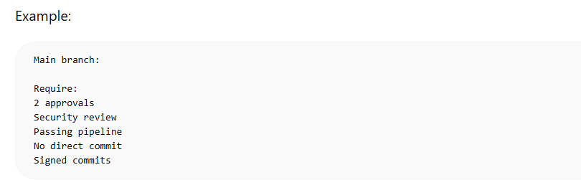

Slide 6
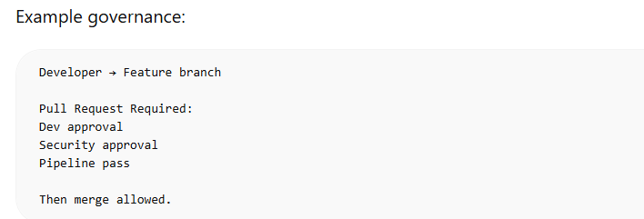

Slide 7
Enterprise controls:
Mandatory:
SAST scan (SonarQube)
Secret detection (GitLeaks)
Dependency scan (Snyk)
IaC scan (Checkov)

Slide 8
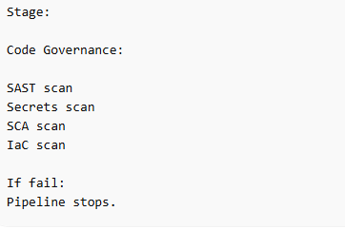
Pipeline example:

Slide 9
Layer 2 — CI/CD Governance
Purpose: Ensure secure build process.
Controls:
Required governance:
Build must:
Use approved base images
Use secure build agent
Generate SBOM
Sign artifacts
Store provenance

Slide 10
Layer 3 — Container Image Governance
Purpose: Ensure only trusted images run.
Controls:
Required:
Image must:
Be scanned
Be signed
Have no critical CVE
Come from approved registry
Have SBOM

Slide 11
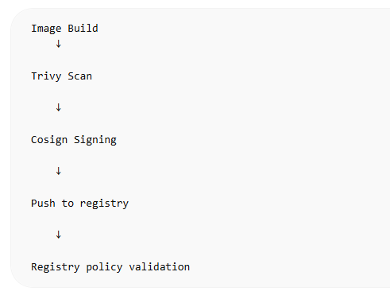
Enterprise model:

Slide 12
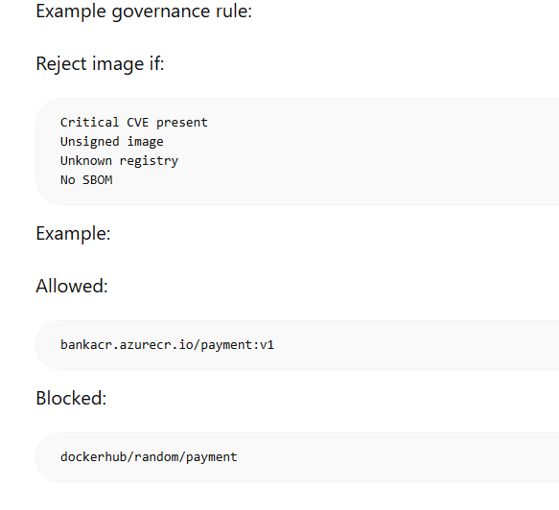
Example governance rule:
Reject image if:

Slide 13
Layer 4 — Deployment Governance
Purpose: Stop bad workloads before cluster.
Implemented via:
Admission controllers.
Enterprise governance engine:
OPA Gatekeeper
Kyverno
Kubewarden

Slide 14
Typical bank policies:
Block:
Latest tag:
image: payment:latest
Require:
image: payment:v1.4

Slide 15
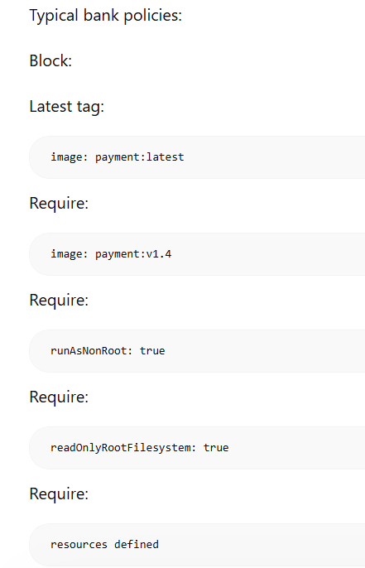

Slide 16
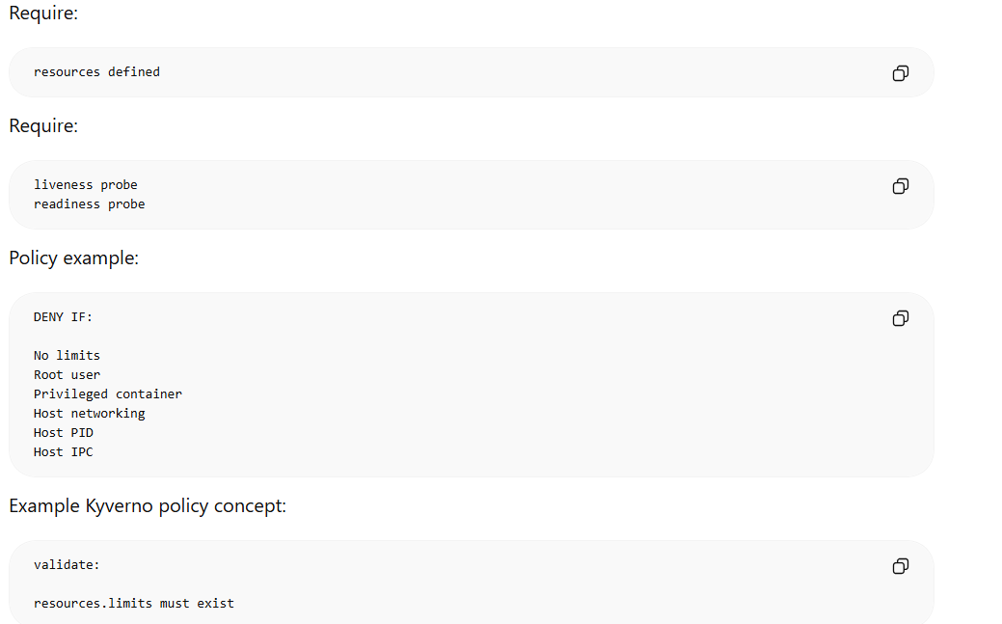
Result: Deployment rejected automatically.

Slide 17
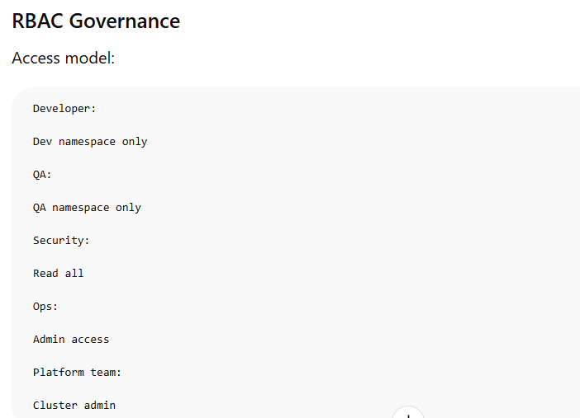
Layer 5 — Kubernetes Cluster Governance Core enterprise controls:

Slide 18
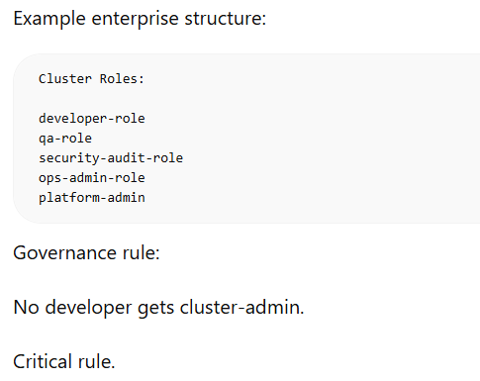
Example enterprise structure:

Slide 19
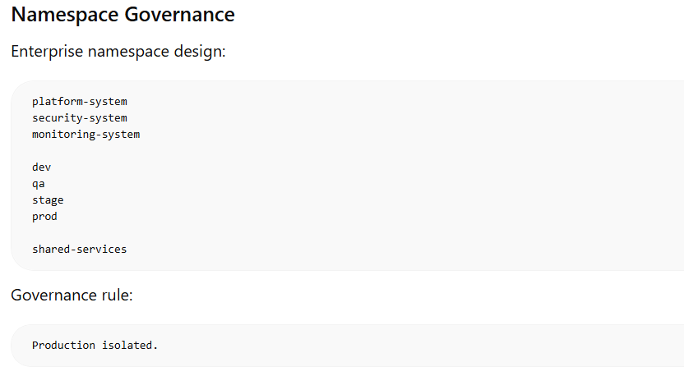

Slide 20
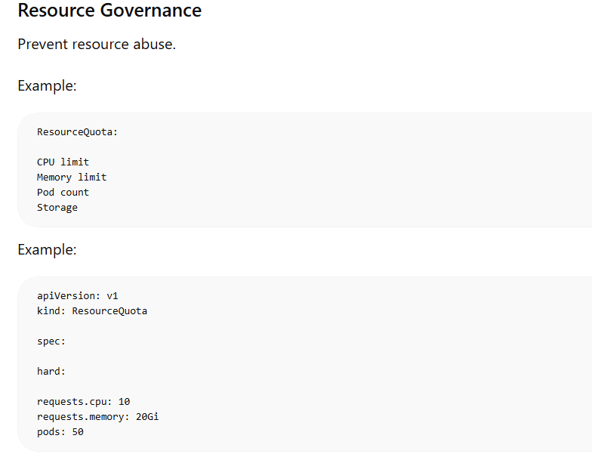

Slide 21
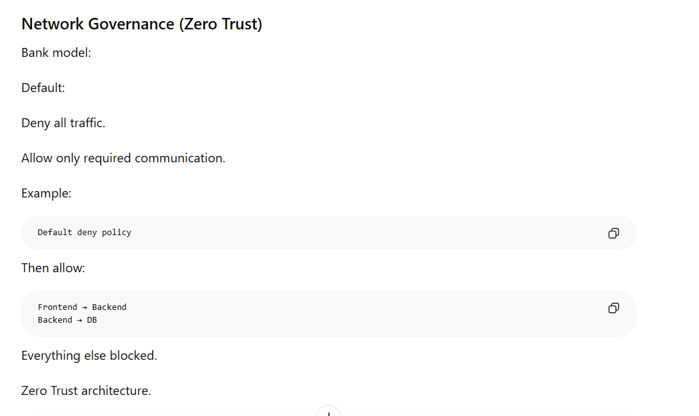

Slide 22
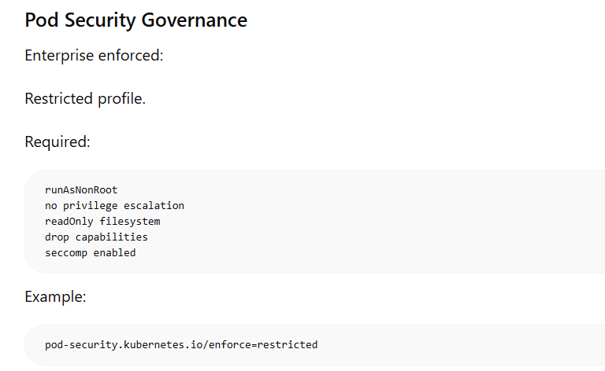

Slide 23
Layer 6 — Runtime Governance
Purpose: Detect attacks.
Runtime security monitors:
Detect:
Crypto mining Reverse shells Privilege escalation Container escape Malware execution
Enterprise runtime tools:
Falco
Aqua runtime
Prisma runtime
Sysdig

Slide 24
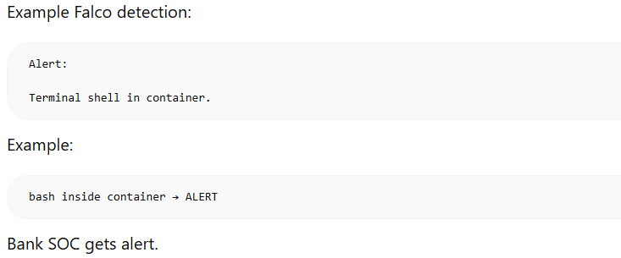

Slide 25
Layer 7 — Compliance Governance
Purpose: Audit and compliance reporting.
Required controls:
Audit logging:

Slide 26
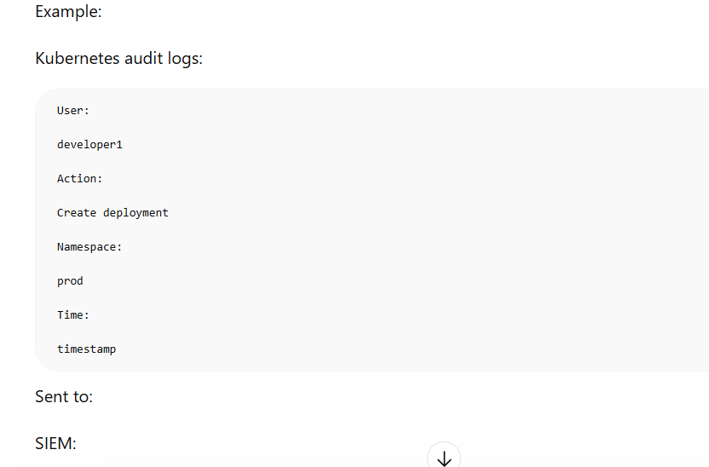

Slide 27
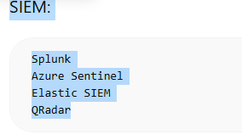

Slide 28
Compliance dashboards:
Show:
PCI compliance score CIS benchmark score Vulnerability trends Policy violations
Tools:
Kubescape
kube-bench
kube-hunter

Slide 29
Enterprise Governance Tool Stack (Real Bank Example) Typical enterprise stack:
Area | Tool
SAST | SonarQube
SCA | Snyk
Secrets | GitLeaks
IaC | Checkov
Image Scan | Trivy
Signing | Cosign
SBOM | Syft
Policy | OPA
Admission | Kyverno
Runtime | Falco
Compliance | Kubescape
Monitoring | Prometheus
SIEM | Splunk

Slide 30
Real Bank Governance Golden Rules
Banks typically enforce rules like: Critical rules:
No root containers
No privileged pods
No latest images
No unsigned images
No plaintext secrets
Mandatory limits
Mandatory probes
TLS required
RBAC enforced
Network isolation required
Audit logging required

Slide 31
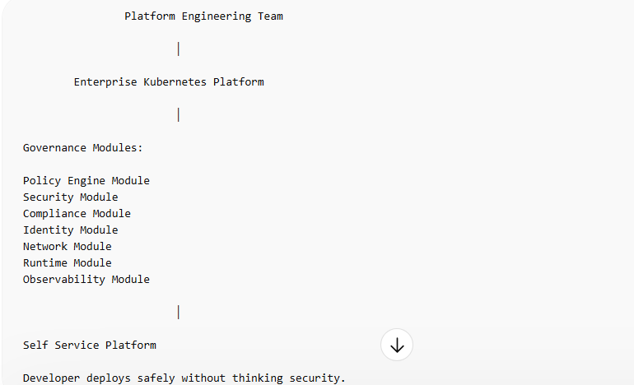
Enterprise Kubernetes Governance Platform Architecture Real enterprise platform teams build:

Slide 32
This is called: Internal Developer Platform (IDP)
Used by:
Banks Airlines Payment companies Insurance

Slide 33
Enterprise Maturity Model
Level 1:
Basic cluster
Level 2:
RBAC + namespaces
Level 3:
Security scanning
Level 4:
Policy enforcement
Level 5:
Full governance automation platform
Banks operate here.

Slide 34
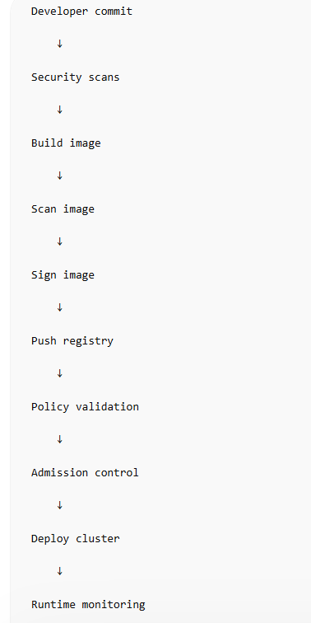
Real Deployment Flow (Bank Example) Real enterprise deployment flow:

Slide 35
Fully automated governance.

